Slide 1

Butler County LOSS/DOSS
Survivor Support
, 2023
From Previous Volunteer Information Meeting on May 19, 2026
Sponsored by:
Envision Partnerships
Butler County Suicide Prevention Coalition

Slide 2
Butler County
LOSS/DOSS
Survivor Support
LOSS - Local Outreach to Suicide Survivors
DOSS – Drug Overdose Survivor Support

Slide 3
Who We Are
PROGRAM HISTORY & GROWTH
* Discussion began in 2021 by exploring the needs and opportunities.
* Formed a committee through the Suicide Prevention Coalition in 2022.
* Through committee discussion, decided to add the DOSS team model.
* Met with Chief Robert Chabali at Fairfield Township Police Dept.
* Participated in LOSS/DOSS training provided by Suicide Postvention Consulting.
* Began exploring procedures and processes.

Slide 4
* Received grant Ohio Suicide Prevention Foundation and funds from Corn Stand Jam.
* Developed Logo and marketing materials.
* Began recruiting volunteers.
* First Volunteer Information Session Aug. 2, 2023
* LOSS was the focus of Walk to Remember. Fundraising and Speaker.
* Began Application and Interviewing Process.
* Hired LOSS/DOSS Team Coordinator, Feb 2024.
* Initial Volunteer Trainings took place late Feb., early Mar. & May 2024
Promote & offer Butler County Suicide/Drug Overdose Loss Support Group beginning June 2024
Scene Response Pilot began July 2024

Slide 5
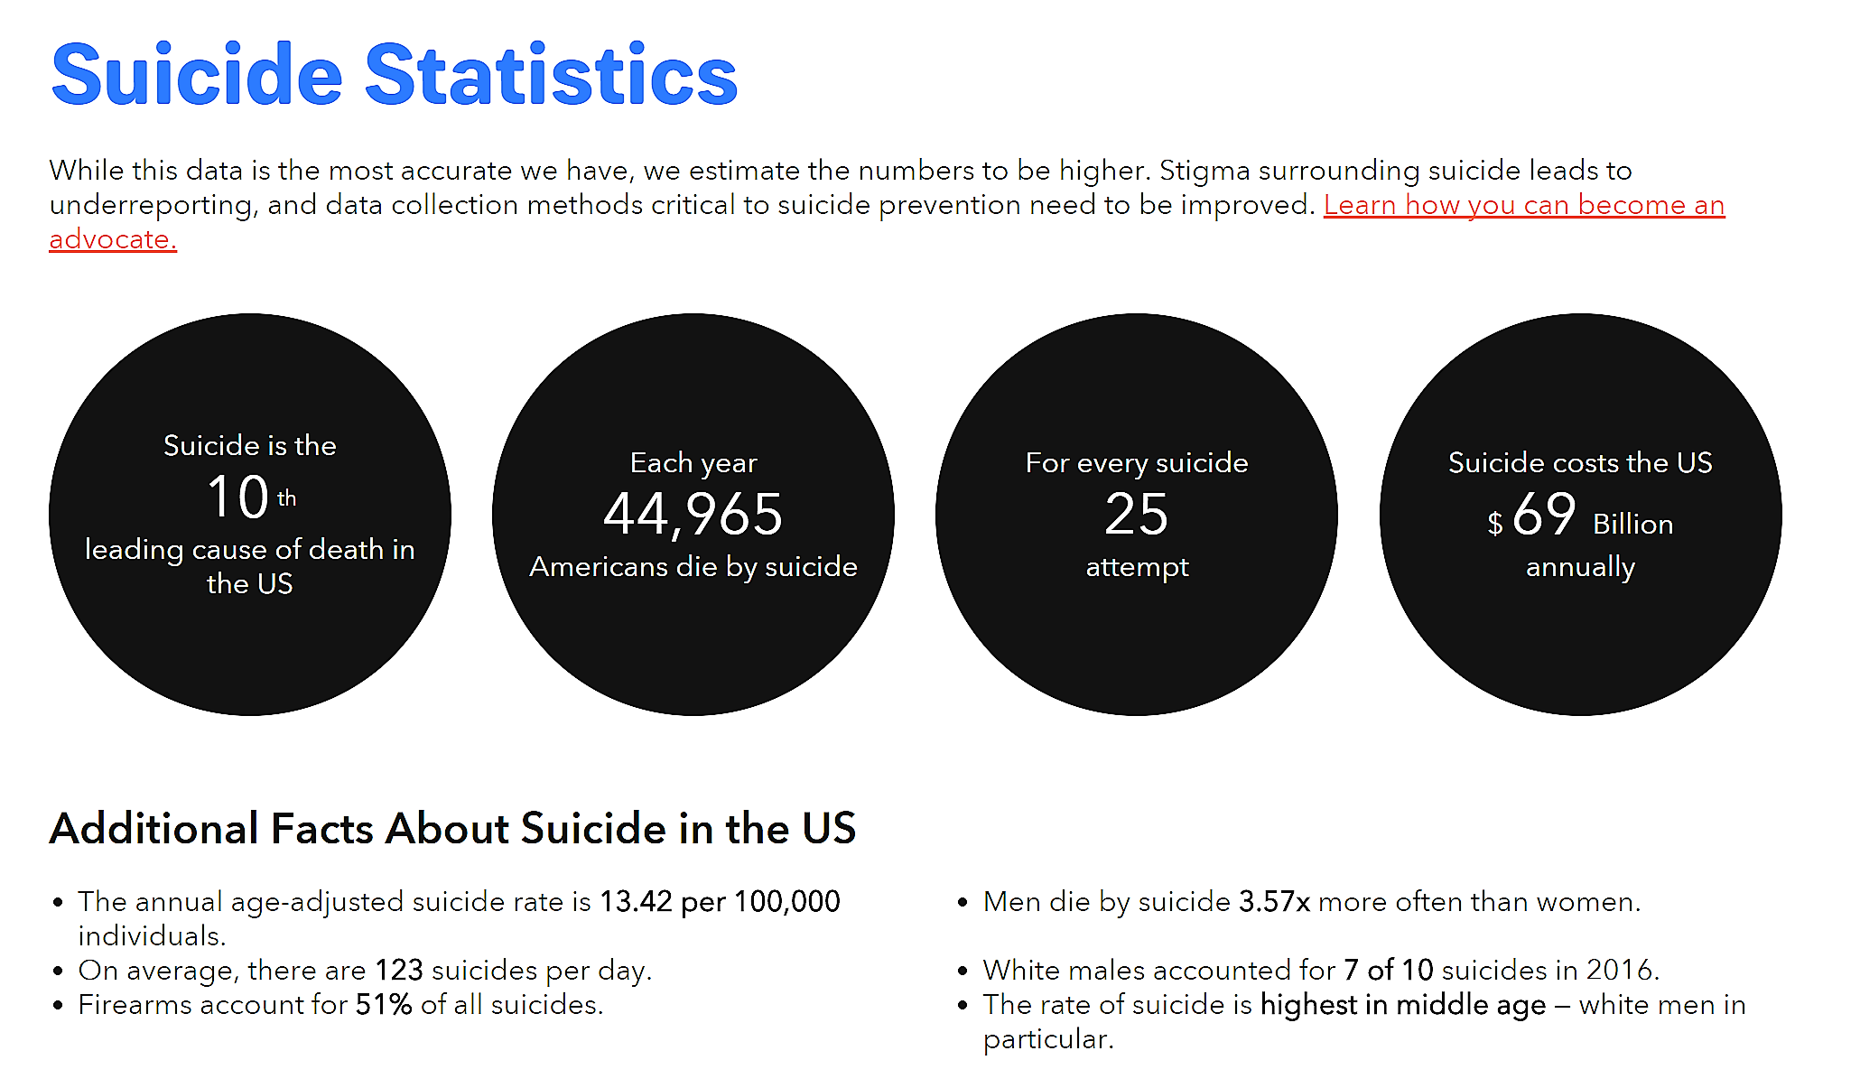
Impact of Suicide: Suicide at a National Level

Slide 6
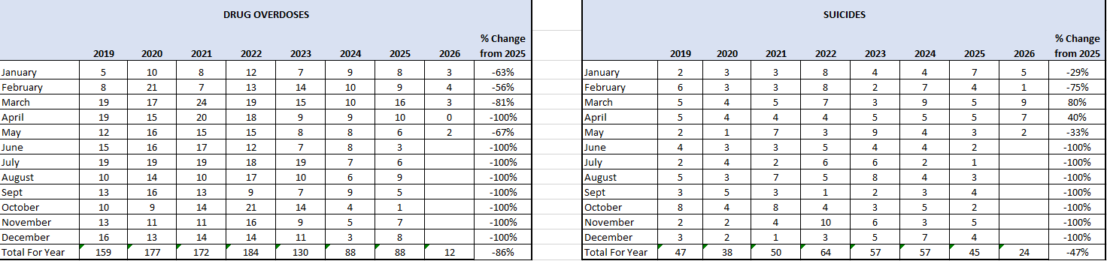
Impact of Suicide and Drug Overdoses at a Local Level: Butler County through 5/13/26

Slide 7
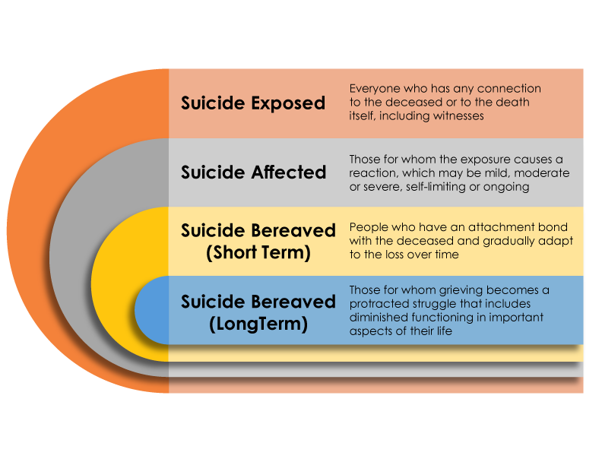
IMPACT OF SUICIDE
https://onlinelibrary.wiley.com/doi/pdf/10.1111/sltb.12450
7
Notes:
https://onlinelibrary.wiley.com/doi/pdf/10.1111/sltb.12450

Slide 8
LOSS/DOSS Overview Video
LOSS Teams (youtube.com)

Slide 9

What We Do
We are volunteers trained to provide resources, healing support and hope to those grieving a loss through suicide or drug overdose, beginning at the time of bereavement and continuing through follow-up support.

Slide 10
LONG TERM LOSS/DOSS Goals
  Respond to the scene of a suicide or overdose death in Butler County with a two person team of volunteers.
  Follow-up with the newly bereaved as appropriate.
  Acknowledge their pain by listening, holding a hand, and creating a safe environment for sharing and healing.
  Equip volunteers and community leaders with knowledge about how to serve the bereaved.
  Collaborate with organizations throughout the community to decrease stigma and provide resources.
  Advocate through the local community and beyond for suicide and drug overdose prevention and postvention awareness.
  Develop support group for LOSS/DOSS survivors.

Slide 11
Volunteers Needed
We are a volunteer dependent organization.
We need you and the unique skills you bring
to help us be successful.

Slide 12
Benefits
  There are many psychological and physical health benefits to volunteering. Some of the ways you benefit from volunteering are:
      Volunteering connects you to others
      Volunteering is good for your mind and body
      Volunteering can give you a sense of purpose
      Volunteering can be healing
      Volunteering can advance your career
      Volunteering brings fun and fulfillment to your life
Notes:
Volunteering allows you to connect to your community and make it a better place. Even helping out with the smallest tasks can make a real difference to the lives of survivors of suicide loss. And volunteering is a two-way street: It can benefit you and your family as much as the cause you choose to help. Dedicating your time as a volunteer helps you make new friends, expand your network, and boost your social skills.
Volunteering helps counteract the effects of stress, anger, and anxiety. The social contact aspect of helping and working with others can have a profound effect on your overall psychological well-being. Nothing relieves stress better than a meaningful connection to another person.
Volunteering combats depression. Volunteering keeps you in regular contact with others and helps you develop a solid support system, which in turn protects you against depression.
Volunteering makes you happy. By measuring hormones and brain activity, researchers have discovered that being helpful to others delivers immense pleasure. Human beings are hard-wired to give to others. The more we give, the happier we feel.
Volunteering increases self-confidence. You are doing good for others and the community, which provides a natural sense of accomplishment. Your role as a volunteer can also give you a sense of pride and identity. And the better you feel about yourself, the more likely you are to have a positive view of your life and future goals.
Just because volunteer work is unpaid does not mean the skills you learn are basic. Many of our volunteering opportunities provide extensive training. For example, our 1st responder program and companion program
Volunteering can also help you build upon skills you already have and use them to benefit the greater community. For instance, if you hold a successful sales position, you raise awareness for Franklin County LOSS as a volunteer advocate, while further developing and improving your public speaking, communication, and marketing skills.
Volunteering is a fun and easy way to explore your interests and passions. Doing volunteer work you find meaningful and interesting can be a relaxing, energizing escape from your day-to-day routine of work, school, or family commitments. Volunteering also provides you with renewed creativity, motivation, and vision that can carry over into your personal and professional life.

Slide 13
Volunteer Opportunities
Scene Activation Team Member
Scene Response Team Member
Survivor Follow Up Support Team Member
Community Events Team Member
Administrative Support or Fundraising Team Member
Grief Support Group Facilitator

Slide 14
Scene Activation Team Member
Needs: Reliable, consistent, attention to detail, good communication skills
  Training Time: 7 hours initial Team training TBD, plus additional 1.5 hours training to learn scene activation protocols
  You will be:
  Scheduled for shifts within the 24/7 on-call schedule
  Must be able to receive the call with pertinent information about the suicide or drug overdose death
  Call out the 2-person volunteer scene response team in a timely manner

Slide 15
Scene Response Team Member
  Teams of 2 trained volunteers – one must be a loss survivor
  Needs: Reliable, Good Listener, Empathetic, Strong Communicator, Calm, Comfortable in your recovery, Valid Driver’s License and Auto Insurance.
  Training Time: 16 Hours Minimum Training
  In person: 7 hours initial Team training TBD, 2 hours scene simulation -TBD,
  QPR 2 hours -TBD
  You will learn how to offer support to survivors immediately following the death
      9 hours in person learning about suicide grief, crime scene etiquette, on-scene communication skills, cultural diversity training, community services/resources for survivors, immediate survivor needs, logistics, paperwork, protocol, role play, self-care, QPR.
      5 hours of online training and certification in Psychological First Aid
        MUST HAVE THIS COMPLETED OR YOU CANNOT ATTEND A SCENE

Slide 16
Survivor Follow Up Support Team Member
  Needs: Reliable, calm, empathetic, good communication skills, comfortable in your own recovery
  Training Time: 14 Hours minimum training
  In Person: 7 hours initial Team training - TBD, 2 hours QPR training - TBD
      5 hours of online training and certification in Psychological First Aid
  You will learn how to provide on-going support for survivors
        Phone/Email outreach
        Follow-up visits (“companion” survivors)
        Hand-written personal notes

Slide 17
Survivor Follow Up Support Team Member
  Needs: Reliable, calm, empathetic, good communication skills, comfortable in your own recovery
  Training Time: 14 Hours minimum training
  In Person: 7 hours initial Team training - TBD, 2 hours QPR training - TBD
      5 hours of online training and certification in Psychological First Aid
  You will learn how to provide on-going support for survivors
        Phone/Email outreach
        Follow-up visits (“companion” survivors)
        Hand-written personal notes

Slide 18
Community Events Team Member
  Needs: Good communication skills, comfortable with groups
  Training Time: 7 hours Initial Team training - TBD
  You will:
  Interact with survivors and the general public at events.
    Visit funeral homes, cemeteries – introduction and leave resources
    Assist with event for International Overdose Awareness Day
    Assist with Walk to Remember for World Suicide Prevention Day
    Create event for International Survivor Suicide Day
    Training will prepare you for:
        Initiating Conversations
        Sharing appropriate resources
        Boundaries
        Setting up information table
        Sharing your story if applicable/appropriate
Notes:
Opportunities to support include staffing events such as:
International Survivor of Suicide LOSS day
Annual Out of the Darkness Walk
Various other event opportunities including mental health fairs, etc

Slide 19
Administrative Support or Fundraising Team Member
  Needs: Reliable, Networking, Consistent
  Training Time: 7 hours Initial team training - TBD
  Additional training TBD- based on need
  Tasks include:
      Assembling Resource Folders/Care Packages for loss survivors
      Organizing Supplies
      Future Newsletter
      Database Maintenance
      Fundraising for A Walk to Remember

Slide 20
Grief Support Group Facilitator
Individuals must have previous facilitation experience and attend a 2-day grief support facilitator training to volunteer as a grief support group facilitator. (no current training taking place right now)
Must commit to regularly facilitate the monthly support group.
Must be reliable, compassionate, and a good listener.
Having experienced a loss to suicide or unintentional drug overdose or grief-informed counseling experience would be beneficial as the facilitator of a grief support group specific for suicide or unintentional overdose loss.

Slide 21
Volunteers
All volunteers are part of the LOSS/DOSS team and will be required to attend some meetings/events for:
  Networking
  Support
  Self Care
  Ongoing training
Number and type of meetings will be determined by volunteer duties; monthly or quarterly.

Slide 22
Next Steps: Requirements
  Application – Return ASAP
  Interview – Take place during September
  Background check after interview
  Psychological First Aid completed before initial training (if interested in being Scene Response or Survivor Follow-up Support Team Member)

Slide 23
Application/Interviews
For those interested, return your application ASAP to jmaclean@envisionpartnerships.com
Interviews will take place during September
Next volunteer training Saturday 9/26/26 9am-4pm

Slide 24
THANK YOU!

