Slide 1

Butler County LOSS/DOSS
Survivor Support
, 2023
Volunteer Information Meeting
Sponsored by:
Envision Partnerships
Butler County Suicide Prevention Coalition

Slide 2

Information to be shared:
Who We Are
What We Do
Why We Need You

Slide 3

Butler County
LOSS/DOSS
Survivor Support
LOSS - Local Outreach to Suicide Survivors
DOSS – Drug Overdose Survivor Support

Slide 4
Who We Are
PROGRAM HISTORY & GROWTH
* Discussion began in 2021 by exploring the needs and opportunities.
* Formed a committee through the Suicide Prevention Coalition in 2022.
* Through committee discussion, decided to add the DOSS team model.
* Met with Chief Robert Chabali at Fairfield Township Police Dept.
* Participated in LOSS/DOSS training provided by Suicide Postvention Consulting.
* Began exploring procedures and processes.

Slide 5
* Received grant Ohio Suicide Prevention Foundation and funds from Corn Stand Jam.
* Developed Logo and marketing materials.
* Began recruiting volunteers.
* First Volunteer Information Session Aug. 2, 2023
* LOSS was the focus of Walk to Remember. Fundraising and Speaker.
* Began Application and Interviewing Process.
* Hired LOSS/DOSS Team Coordinator.
* Initial Volunteer Trainings took place late Feb., early Mar. & May
* Promote & offer Butler County Suicide/Drug Overdose Loss Support Group beginning June 18, 2024 6:30-8pm (continue monthly - 3rd Tuesday each month)

Slide 6
LOSS/DOSS Development Committee:
  Kristen Smith – BC Suicide Prevention Coalition Chair – Envision Partnerships
  Rhonda Benson – LOSS/DOSS Subcommittee Chair - NAMI Butler County
  Jennifer MacLean – LOSS/DOSS Team Coordinator – Envision Partnerships
  Thelma Hodge – Cincinnati VA
  Lisa Mannix – BC Coroner’s Office
  Carissa Piper –Beckett Springs Hospital
  Denise Meine-Graham – Ohio Suicide Prevention Foundation
  Martina Weber – BC Mental Health and Addiction Recovery Services Board
  Joshua Jowers –Cincinnati VA
  Lisa Carter – Mental Health Matters
  Grace Carr – NAMI Butler County
  Heather Wells – Miami University
  Dorothy McMake
  Mark York – West Chester Police Department

Slide 7
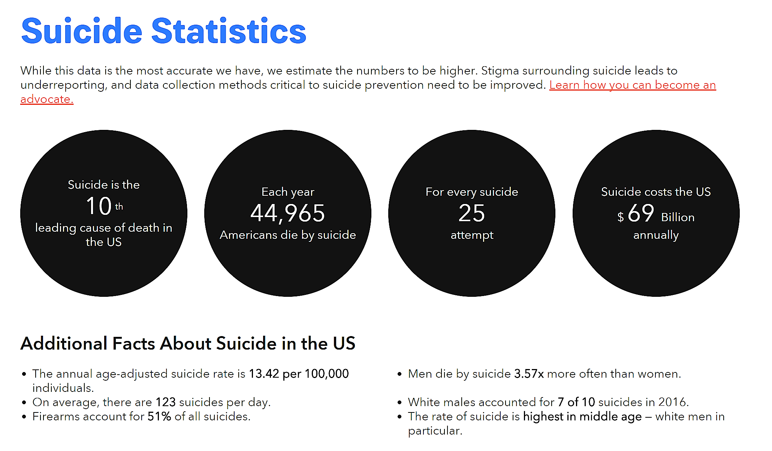
Impact of Suicide: Suicide at a National Level

Slide 8
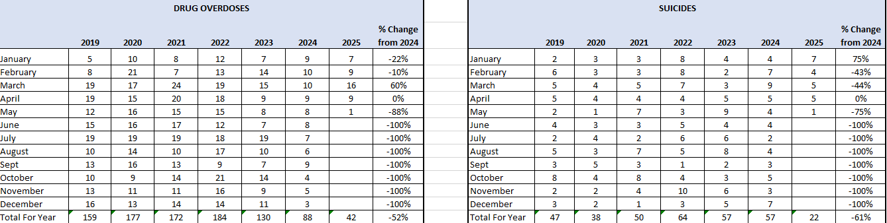
Impact of Suicide and Drug Overdoses at a Local Level: Butler County through 5/07/25

Slide 9
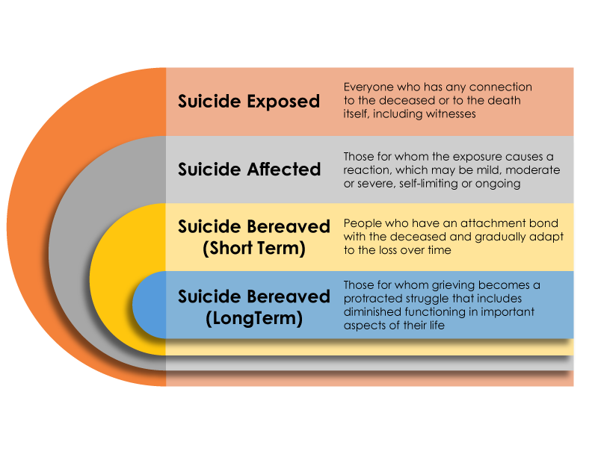
IMPACT OF SUICIDE
https://onlinelibrary.wiley.com/doi/pdf/10.1111/sltb.12450
9
Notes:
https://onlinelibrary.wiley.com/doi/pdf/10.1111/sltb.12450

Slide 10
LOSS/DOSS Overview Video
LOSS Teams (youtube.com)

Slide 11

What We Do
We are volunteers trained to provide resources, healing support and hope to those grieving a loss through suicide or drug overdose, beginning at the time of bereavement and continuing through follow-up support.

Slide 12
LONG TERM LOSS/DOSS Goals
  Respond to the scene of a suicide or overdose death in Butler County with a two person team of volunteers.
  Follow-up with the newly bereaved as appropriate.
  Acknowledge their pain by listening, holding a hand, and creating a safe environment for sharing and healing.
  Equip volunteers and community leaders with knowledge about how to serve the bereaved.
  Collaborate with organizations throughout the community to decrease stigma and provide resources.
  Advocate through the local community and beyond for suicide and drug overdose prevention and postvention awareness.
  Develop support group for LOSS/DOSS survivors.

Slide 13
Team Members Needed
We are a volunteer dependent organization.
We need you and the unique skills you bring
to help us be successful.

Slide 14
Benefits
  There are many psychological and physical health benefits to volunteering. Some of the ways you benefit from volunteering are:
      Volunteering connects you to others
      Volunteering is good for your mind and body
      Volunteering can give you a sense of purpose
      Volunteering can be healing
      Volunteering can advance your career
      Volunteering brings fun and fulfillment to your life
Notes:
Volunteering allows you to connect to your community and make it a better place. Even helping out with the smallest tasks can make a real difference to the lives of survivors of suicide loss. And volunteering is a two-way street: It can benefit you and your family as much as the cause you choose to help. Dedicating your time as a volunteer helps you make new friends, expand your network, and boost your social skills.
Volunteering helps counteract the effects of stress, anger, and anxiety. The social contact aspect of helping and working with others can have a profound effect on your overall psychological well-being. Nothing relieves stress better than a meaningful connection to another person.
Volunteering combats depression. Volunteering keeps you in regular contact with others and helps you develop a solid support system, which in turn protects you against depression.
Volunteering makes you happy. By measuring hormones and brain activity, researchers have discovered that being helpful to others delivers immense pleasure. Human beings are hard-wired to give to others. The more we give, the happier we feel.
Volunteering increases self-confidence. You are doing good for others and the community, which provides a natural sense of accomplishment. Your role as a volunteer can also give you a sense of pride and identity. And the better you feel about yourself, the more likely you are to have a positive view of your life and future goals.
Just because volunteer work is unpaid does not mean the skills you learn are basic. Many of our volunteering opportunities provide extensive training. For example, our 1st responder program and companion program
Volunteering can also help you build upon skills you already have and use them to benefit the greater community. For instance, if you hold a successful sales position, you raise awareness for Franklin County LOSS as a volunteer advocate, while further developing and improving your public speaking, communication, and marketing skills.
Volunteering is a fun and easy way to explore your interests and passions. Doing volunteer work you find meaningful and interesting can be a relaxing, energizing escape from your day-to-day routine of work, school, or family commitments. Volunteering also provides you with renewed creativity, motivation, and vision that can carry over into your personal and professional life.

Slide 15
Team Member Opportunities
Scene Response Team
Survivor Follow Up
Community Awareness/Education Events
Fundraising
Administration Support
Scene Activation Team Volunteer
Grief Group Facilitator

Slide 16
Scene Responder
  Teams of 2 trained volunteers – one must be a survivor
  Needs: Reliable, Good Listener, Empathetic, Strong Communicator, Calm, Comfortable in your recovery, Valid Driver’s License and Auto Insurance.
  Training Time: 16.5 Hours Minimum Initial Training
  In person: 6.5 hours initial Team training
  1.5 hours scene simulation-TBD, QPR 2.5 hours-TBD)
  You will learn how to offer support to survivors immediately following the death
      10.5 hours in person learning about suicide grief, crime scene etiquette, on-scene communication skills, cultural diversity training, community services/resources for survivors, immediate survivor needs, logistics, paperwork, protocol, role play, self-care, QPR.
      5 hours of online training and certification in Psychological First Aid
        MUST HAVE THIS COMPLETED OR YOU CANNOT ATTEND A SCENE

Slide 17
Survivor Follow Up
  Needs: Reliable, calm, empathetic, good communication skills, comfortable in your own recovery
  Training Time: 15 Hours minimum for initial training
  In Person: 6.5 hours initial Team training
  2.5 QPR training (TBD)
  5 hours of online training and certification in Psychological First Aid
  You will learn how to provide on-going support for survivors
        Phone outreach
        Follow-up visits (“companion” survivors)
        Support group participation

Slide 18
Community Awareness/Educational Events
  Needs: Good communication skills, comfortable with groups
  Training Time: 6.5 hours Initial Team training
  You will:
  Interact with survivors and the general public at events.
    Visit funeral homes, cemeteries – introduction and leave resources
    Create/Assist event for International Overdose Awareness Day
    Assist with Walk to Remember for World Suicide Prevention Day
    Create event for International Survivor Suicide Day (Sat. before Thanksgiving)
    Training will prepare you for:
        Initiating Conversations
        Sharing appropriate resources
        Boundaries
        Setting up information table
        Sharing your story if applicable/appropriate
Notes:
Opportunities to support include staffing events such as:
International Survivor of Suicide LOSS day
Annual Out of the Darkness Walk
Various other event opportunities including mental health fairs, etc

Slide 19
Fundraising
  Needs: Reliable, Networking, Consistent
  Training Time: 6.5 hours Initial team training
  Additional training TBD- based on need
  Training will prepare you for:
      Promoting & Sharing Events
      Appropriate Messaging
      Grant research
      Organizing fundraisers

Slide 20
Administrative
  Needs: Reliable, Consistent
  Training Time: 6.5 hours initial Team training
  Additional training TBD- based on need
  Additional training will prepare you for:
  Personal hand-written cards/notes
  Assembling resource packets
  Assembling and mailing care packages
  Copying materials
  Newsletters
  Database maintenance
  Other administrative tasks as needed

Slide 21
Scene Activation Team Volunteer
Needs: Reliable, consistent, attention to detail, good communication skills
  Training Time: 1.5 Hours Team Activation Protocols (TBD-ASAP upon availability)
  6.5 Hours New Volunteer Training (TBD) Total = 8 hours min.
  You will:
  Be scheduled for shifts within the 24/7 on-call schedule (per your availability)
  Must be able to receive the call with pertinent information about the suicide or accidental drug overdose scene
  Call out the 2-person volunteer scene response team in a timely manner
  Receive a follow-up call when team leaves the scene

Slide 22
Volunteers
All volunteers are part of the LOSS/DOSS team and will be required to attend some meetings/events for:
  Networking
  Support
  Self Care
  Ongoing training
Number and type of meetings will be determined by volunteer duties; monthly or quarterly.

Slide 23
Next Steps: Requirements
  Application – Return ASAP
  Interview – Upon receipt of your application
  Background check
  Psychological First Aid (if interested in being Scene Responder or Survivor Follow-up)
  New Volunteer Training (TBD)
  QPR Training

Slide 24
Upcoming Training
For those interested, download the volunteer application from envisionpartnerships.com and return your application asap to
Jennifer MacLean @ jmaclean@envisionpartnerships.com
Interviews will take place upon receipt of application
Volunteer training takes place on a Saturday 9:30am-4pm
Next New Volunteer Training
(TBD)

Slide 25
THANK YOU!

